Slide 1

ECE 603 Probability and Random Processes
Lessons 14-16
Chapter 6
Multiple Random Variables
Notes:
Now: Slides with Annotation
Next: Slides with Annotation
*****Preparation Notes*****
Students taking this course should already have covered linear algebra elsewhere.
We will use linear algebra extensively in this course.

Slide 2
Objectives
Explore joint distributions and independence.
Analyze Moment Generating Functions (MGFs).
Examine random vectors.
© 2020 UMass Amherst Global. All rights reserved.
Notes:
Now: Slides with Annotation
Next: Slides with Annotation

Slide 3
Rationale
Until now in this course, you have been working with one and two random variables and how they might be extended to more.
You will now begin considering three or more variables. As the number of random variables increases, you will notice how the functions become computationally intractable. This leads to an exploration of other techniques.
© 2020 UMass Amherst Global. All rights reserved.
Notes:
Now: Slides with Annotation
Next: Slides with Annotation

Slide 4
Prior Learning
Basic Concepts
Counting Methods
Random Variables
Access to the online textbook: https://www.probabilitycourse.com/
© 2020 UMass Amherst Global. All rights reserved.
Notes:
Now: Slides with Annotation
Next: Slides with Annotation

Slide 5

Joint Distributions and Independence
Let be discrete random variables.
Joint PMF:
© 2020 UMass Amherst Global. All rights reserved.
Notes:
Now: Slides with Annotation
Next: Slides with Annotation

Slide 6
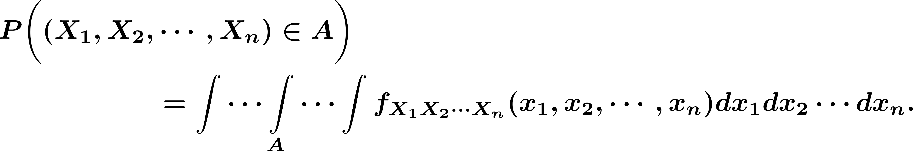
Joint Distributions and Independence
Let be continuous random variables.
Joint PDF:
© 2020 UMass Amherst Global. All rights reserved.
Notes:
Now: Slides with Annotation
Next: Slides with Annotation

Slide 7
Joint Distributions and Independence
The joint CDF of random variables (both discrete and continuous) is defined as
© 2020 UMass Amherst Global. All rights reserved.
Notes:
Now: Slides with Annotation
Next: Slides with Annotation

Slide 8
Joint Distributions and Independence
Random variables are independent, if
Discrete:
Continuous:
© 2020 UMass Amherst Global. All rights reserved.
Notes:
Now: Slides with Annotation
Next: Slides with Annotation

Slide 9
Joint Distributions and Independence
If random variables are independent, then
© 2020 UMass Amherst Global. All rights reserved.
Notes:
Now: Slides with Annotation
Next: Slides with Annotation

Slide 10
Joint Distributions and Independence
Definition. Random variables are said to be independent and identically distributed (i.i.d.) if they are independent, and they have the same marginal distributions :
© 2020 UMass Amherst Global. All rights reserved.
Notes:
Now: Slides with Annotation
Next: Slides with Annotation

Slide 11
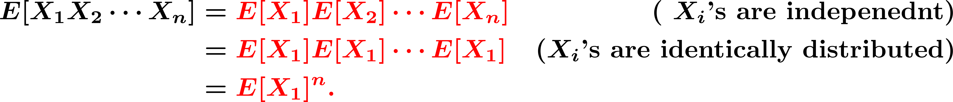
Joint Distributions and Independence
Example. if random variables are i.i.d., they will have the same means and variances, so we can write
© 2020 UMass Amherst Global. All rights reserved.
Notes:
Now: Slides with Annotation
Next: Slides with Annotation

Slide 12

Joint Distributions and Independence
Example. let be i.i.d. with
We define
Find CDF and PDF of
© 2020 UMass Amherst Global. All rights reserved.
Notes:
Now: Slides with Annotation
Next: Slides with Annotation

Slide 13
Sums of Random Variables
With regards to the linearity of expectation:
© 2020 UMass Amherst Global. All rights reserved.
Notes:
Now: Slides with Annotation
Next: Slides with Annotation

Slide 14
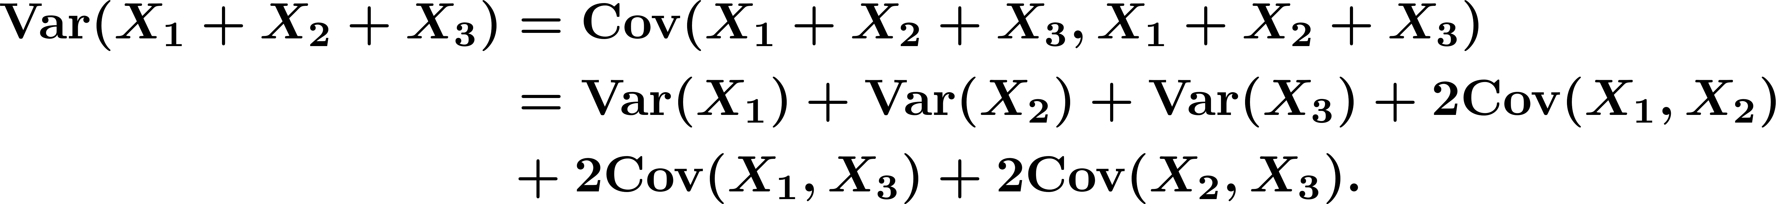
Sums of Random Variables
Variance of a sum of two and three random variables is
© 2020 UMass Amherst Global. All rights reserved.
Notes:
Now: Slides with Annotation
Next: Slides with Annotation

Slide 15
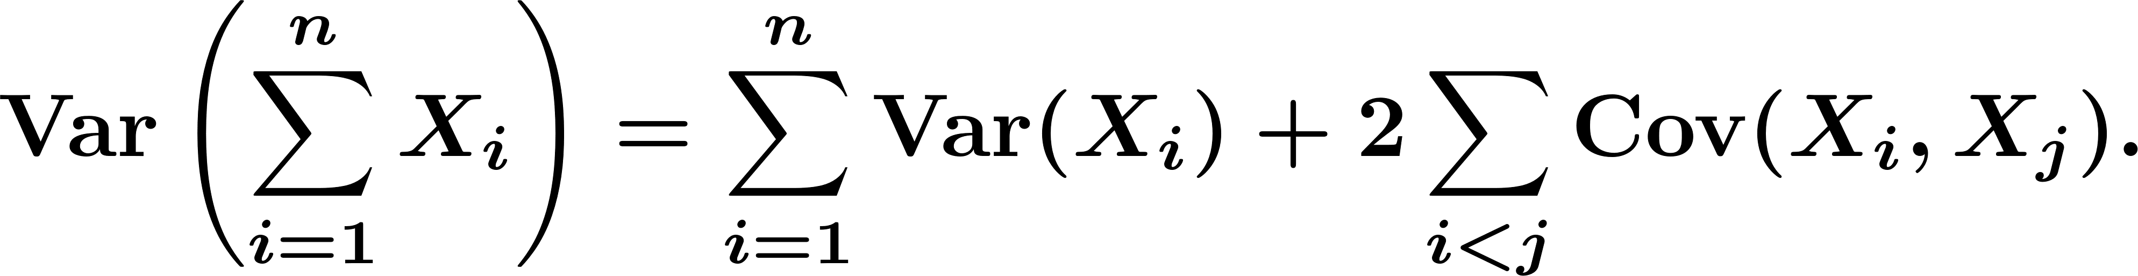
Sums of Random Variables
Generally,
© 2020 UMass Amherst Global. All rights reserved.
Notes:
Now: Slides with Annotation
Next: Slides with Annotation

Slide 16
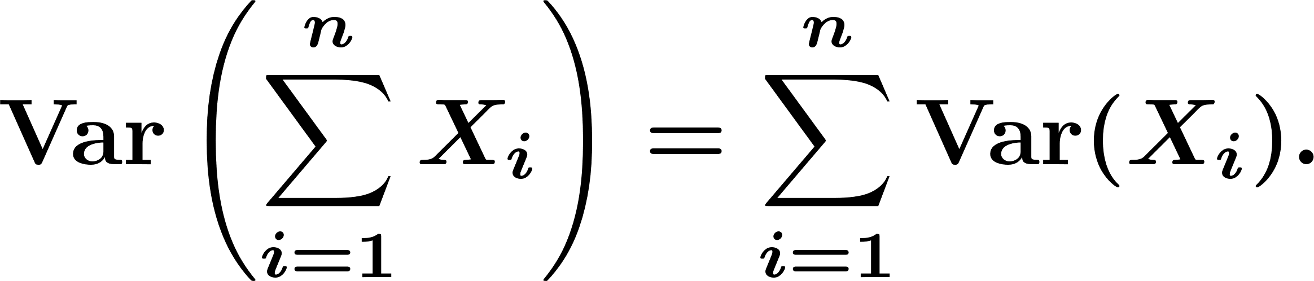
Sums of Random Variables
If are uncorrelated (i.e. ), then
If are independent then they are uncorrelated, thus
© 2020 UMass Amherst Global. All rights reserved.
Notes:
Now: Slides with Annotation
Next: Slides with Annotation

Slide 17




Moment Generating Functions
Definition. The th moment of a random variable is defined to be .
The th central moment of is defined to be .
© 2020 UMass Amherst Global. All rights reserved.
Notes:
Now: Slides with Annotation
Next: Slides with Annotation

Slide 18
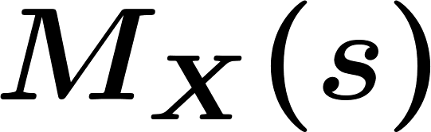
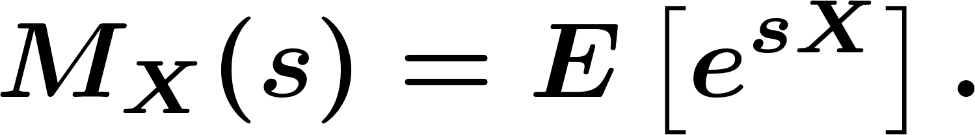

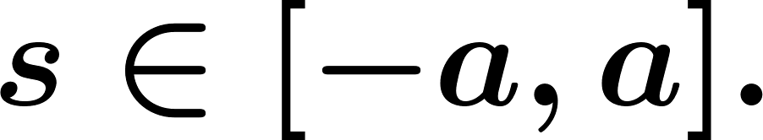
Moment Generating Functions
The moment generating function (MGF) of a random variable is a function
defined as
We say that MGF of exists, if there exists a positive constant such that
is finite for all
© 2020 UMass Amherst Global. All rights reserved.
Notes:
Now: Slides with Annotation
Next: Slides with Annotation

Slide 19
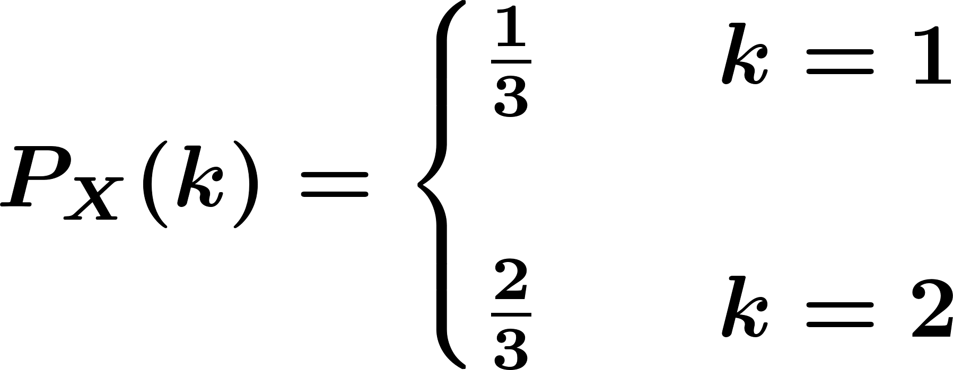


Moment Generating Functions
Example. For each of the following random variables, find the MGF.
is a discrete random variable, with PMF
is a random variable.
© 2020 UMass Amherst Global. All rights reserved.
Notes:
Now: Slides with Annotation
Next: Slides with Annotation

Slide 20
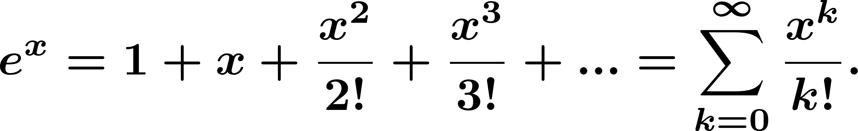
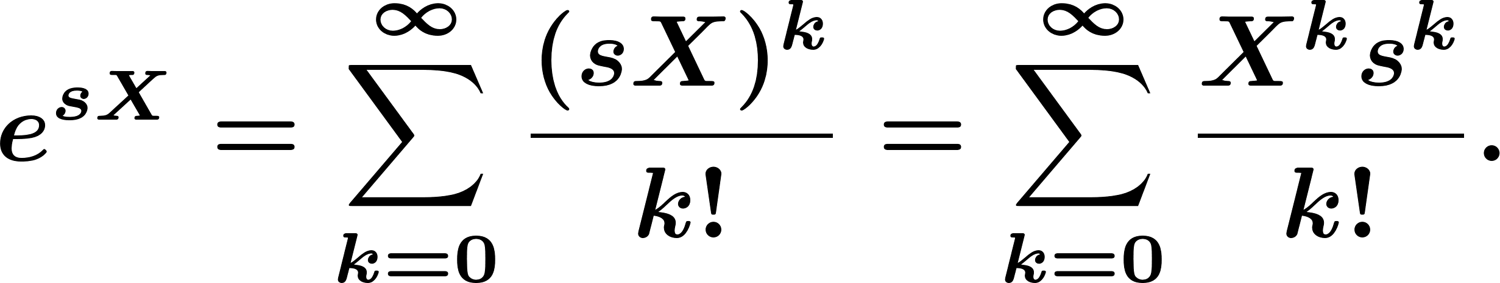
Moment Generating Functions
Finding Moments from MGF:
Remember
© 2020 UMass Amherst Global. All rights reserved.
Notes:
Now: Slides with Annotation
Next: Slides with Annotation

Slide 21
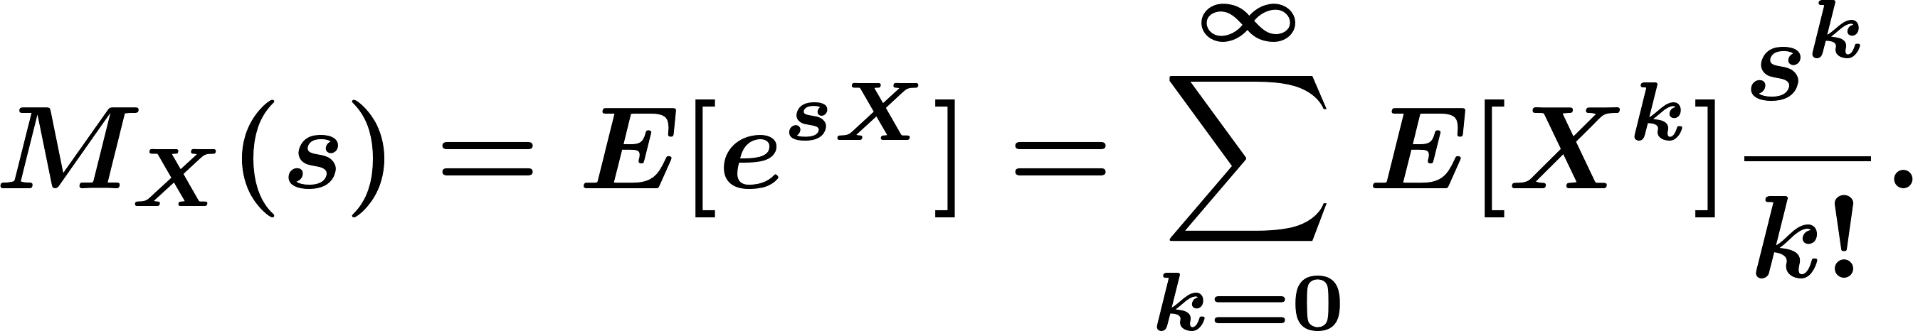
Moment Generating Functions
Thus, we have
© 2020 UMass Amherst Global. All rights reserved.
Notes:
Now: Slides with Annotation
Next: Slides with Annotation

Slide 22

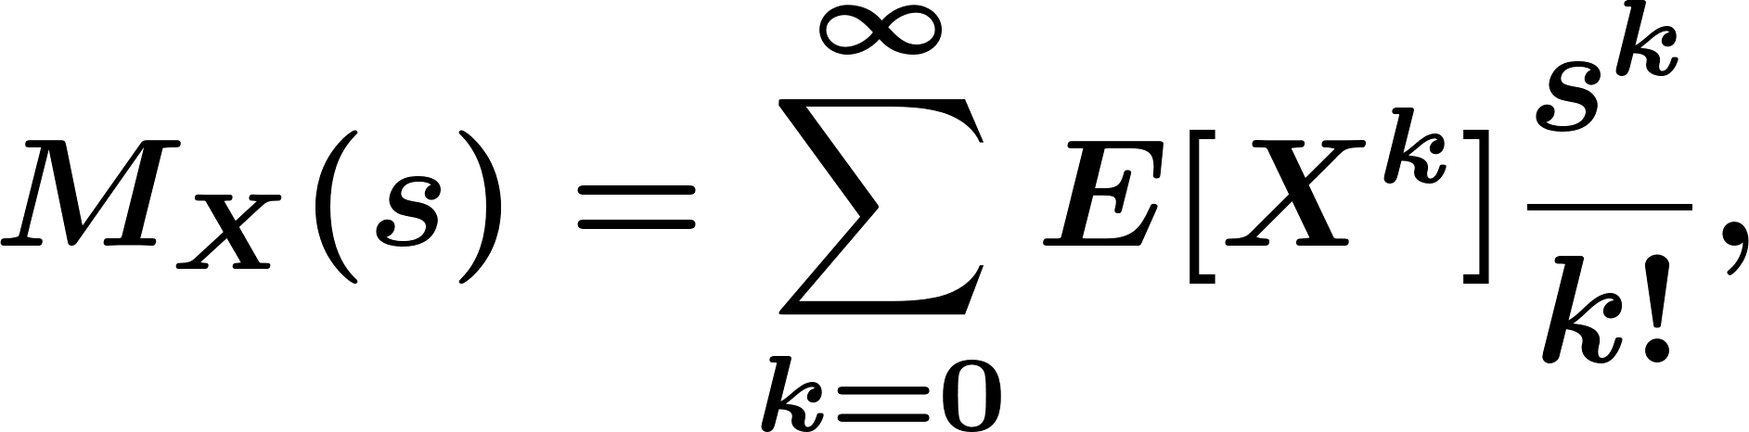
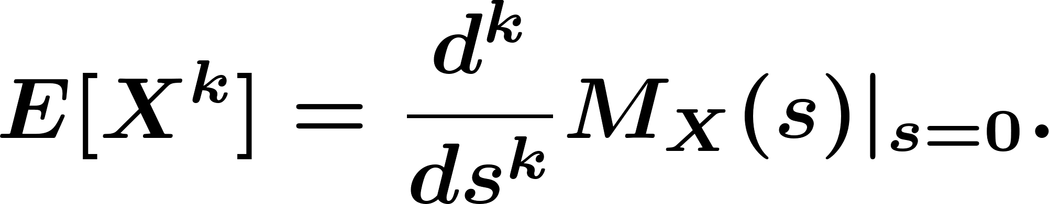
Moment Generating Functions
We can obtain all moments of from its MGF:
© 2020 UMass Amherst Global. All rights reserved.
Notes:
Now: Slides with Annotation
Next: Slides with Annotation

Slide 23
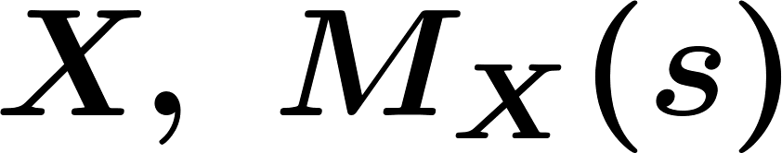
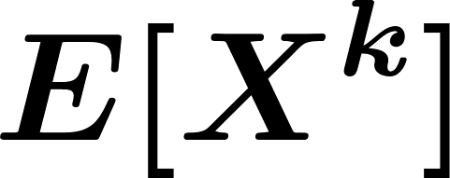
Moment Generating Functions
Example. Let . Find the MGF of , and all of its moments, .
© 2020 UMass Amherst Global. All rights reserved.
Notes:
Now: Slides with Annotation
Next: Slides with Annotation

Slide 24


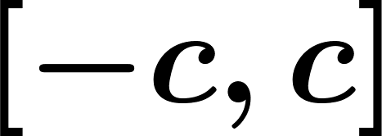
Moment Generating Functions
Theorem. Consider two random variables and . Suppose that there exists a positive constant such that MGFs of and are finite and identical for all values of in . Then,
MGF determines the distribution.
© 2020 UMass Amherst Global. All rights reserved.
Notes:
Now: Slides with Annotation
Next: Slides with Annotation

Slide 25

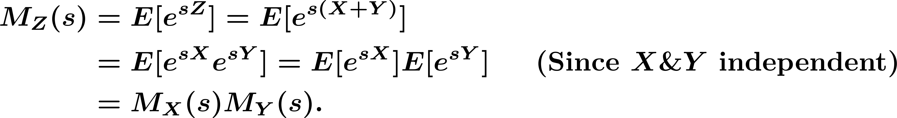
Moment Generating Functions
Sum of Independent Random Variables:
If and are independent RVs and then,
Notes:
Now: Slides with Annotation
Next: Slides with Annotation

Slide 26
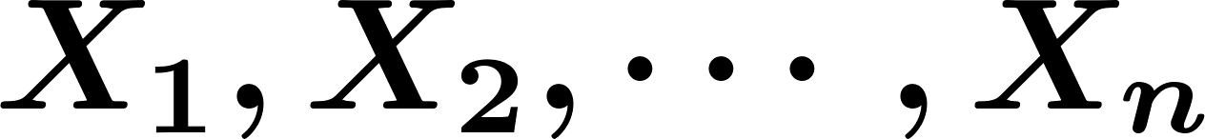
Moment Generating Functions
If are independent random variables, then
Notes:
Now: Slides with Annotation
Next: Slides with Annotation

Slide 27
Moment Generating Functions
Example. If find the MGF of .
Notes:
Now: Slides with Annotation
Next: Slides with Annotation

Slide 28
Moment Generating Functions
Example. Using MGFs prove that if and
are independent, then
Notes:
Now: Slides with Annotation
Next: Slides with Annotation

Slide 29
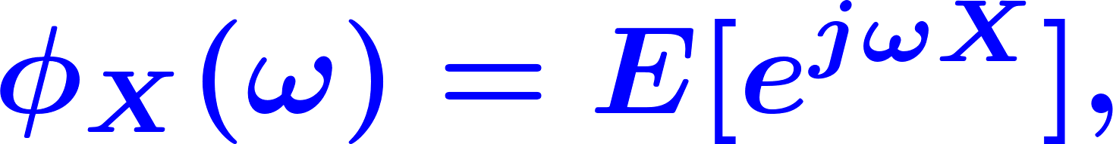
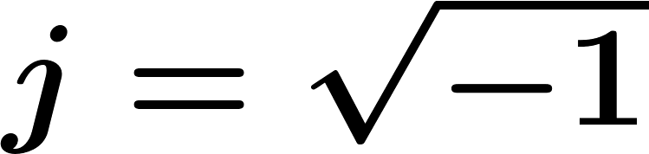

Characteristic Functions
If a random variable does not have a well-defined MGF, we can use the characteristic function defined as
where and is a real number.
Notes:
Now: Slides with Annotation
Next: Slides with Annotation

Slide 30
Characteristic Functions
If and are independent, and , then
Notes:
Now: Slides with Annotation
Next: Slides with Annotation

Slide 31
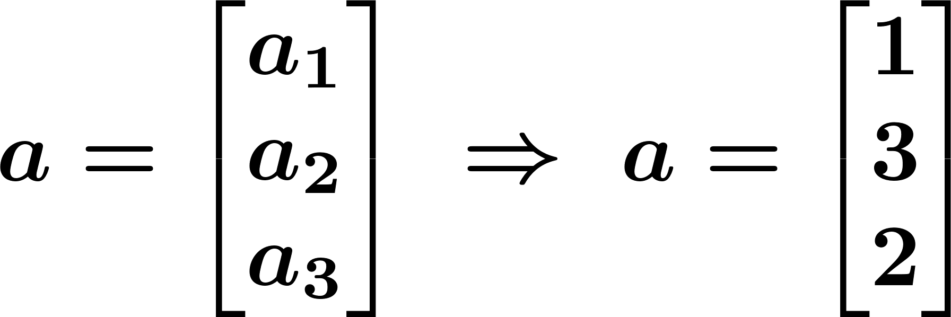
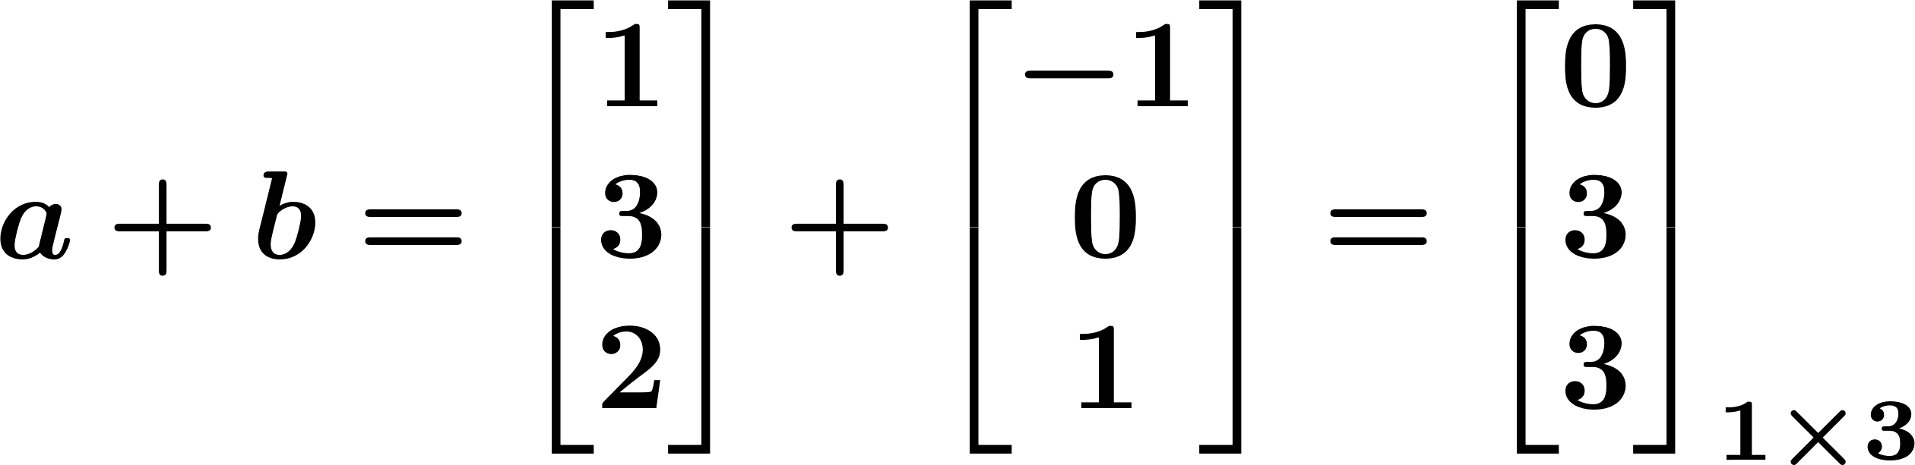
Random Vectors
Vectors
Column vector:
© 2020 UMass Amherst Global. All rights reserved.
Notes:
Now: Slides with Annotation
Next: Slides with Annotation

Slide 32
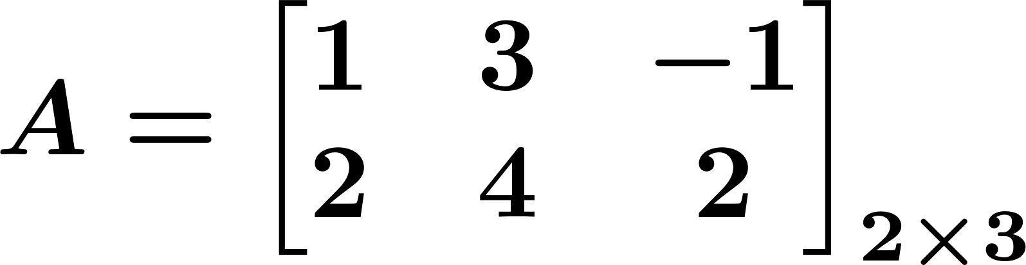
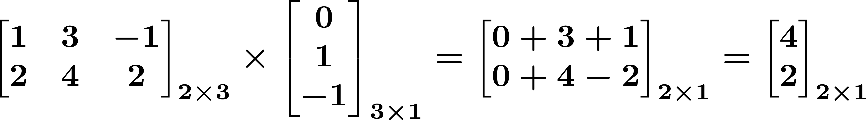

Random Vectors
Matrix multiplication
© 2020 UMass Amherst Global. All rights reserved.
Notes:
Now: Slides with Annotation
Next: Slides with Annotation

Slide 33
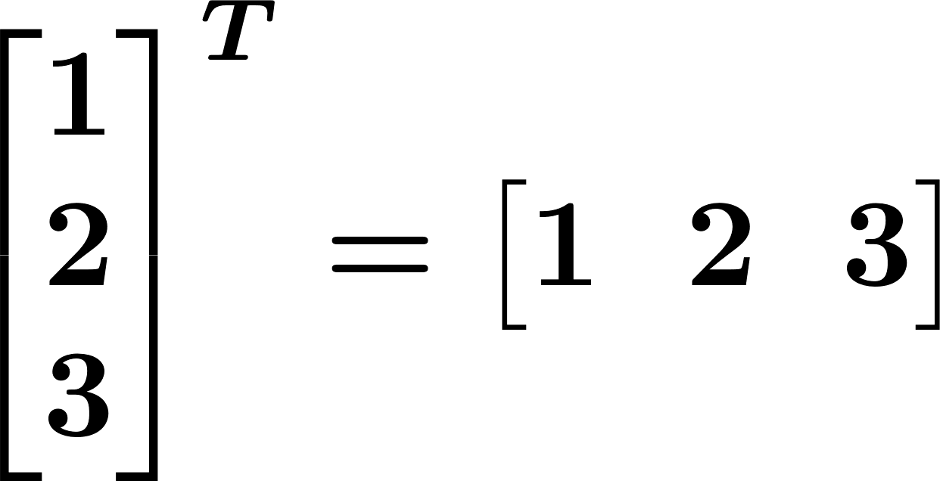
Random Vectors
Matrix multiplication
© 2020 UMass Amherst Global. All rights reserved.
Notes:
Now: Slides with Annotation
Next: Slides with Annotation

Slide 34

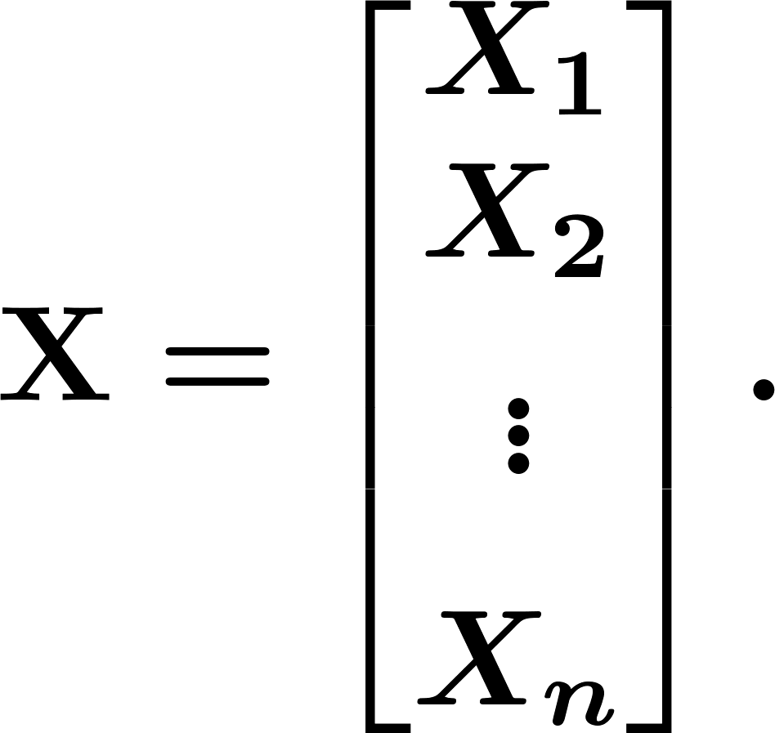
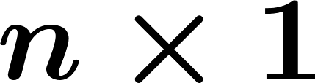
Random Vectors
When we have random variables we can put them in a (column) vector .
© 2020 UMass Amherst Global. All rights reserved.
Notes:
Now: Slides with Annotation
Next: Slides with Annotation

Slide 35

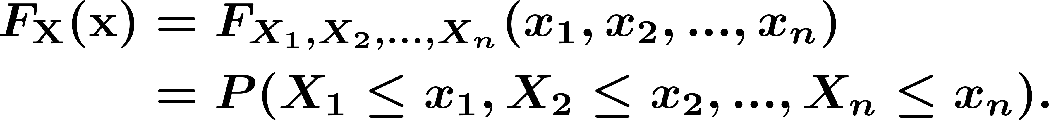
Random Vectors
CDF of the random vector
PDF of the random vector
© 2020 UMass Amherst Global. All rights reserved.
Notes:
Now: Slides with Annotation
Next: Slides with Annotation

Slide 36
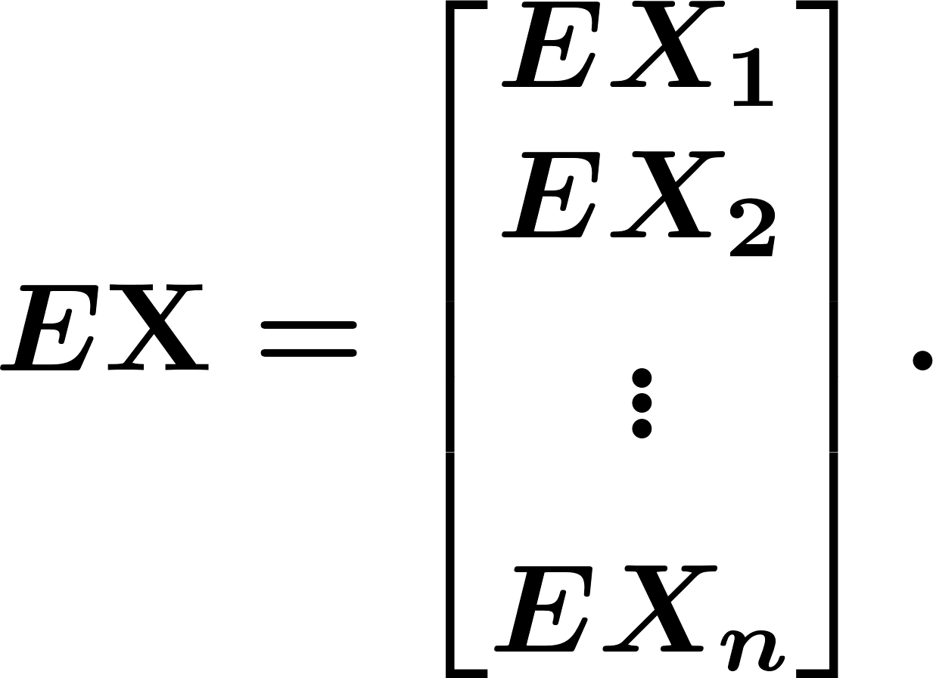
Random Vectors
Expectation:
The expected value vector or the mean vector of the random vector is defined as
© 2020 UMass Amherst Global. All rights reserved.
Notes:
Now: Slides with Annotation
Next: Slides with Annotation

Slide 37
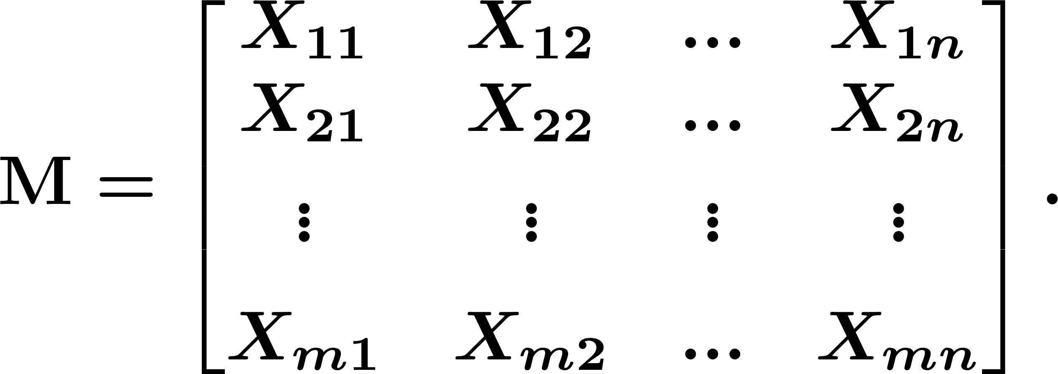
Random Vectors
random matrix
© 2020 UMass Amherst Global. All rights reserved.
Notes:
Now: Slides with Annotation
Next: Slides with Annotation

Slide 38

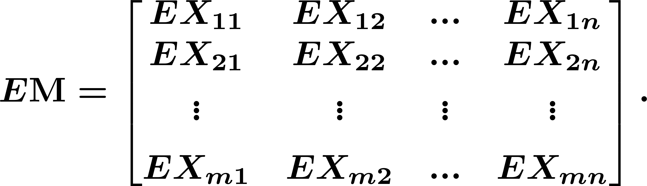
Random Vectors
Mean matrix of
© 2020 UMass Amherst Global. All rights reserved.
Notes:
Now: Slides with Annotation
Next: Slides with Annotation

Slide 39
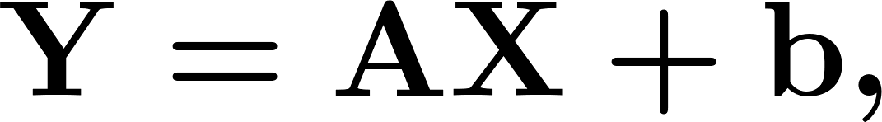
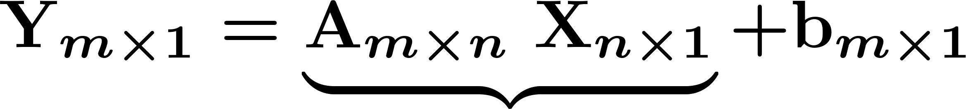

Random Vectors
Linearity of expectation
© 2020 UMass Amherst Global. All rights reserved.
Notes:
Now: Slides with Annotation
Next: Slides with Annotation

Slide 40





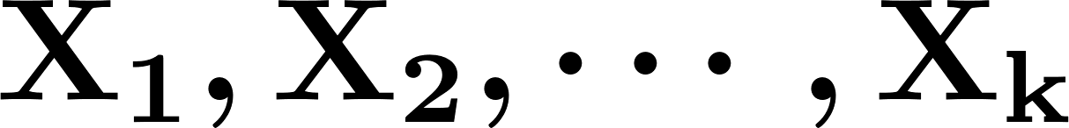
Random Vectors
Linearity of expectation
Also, if are -dimensional random vectors, then we have
© 2020 UMass Amherst Global. All rights reserved.
Notes:
Now: Slides with Annotation
Next: Slides with Annotation

Slide 41
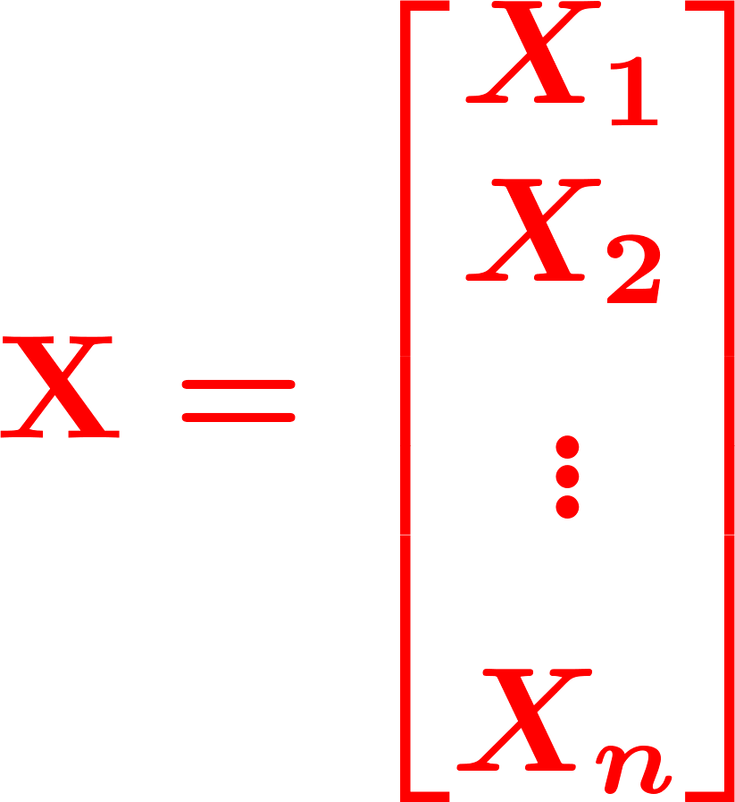
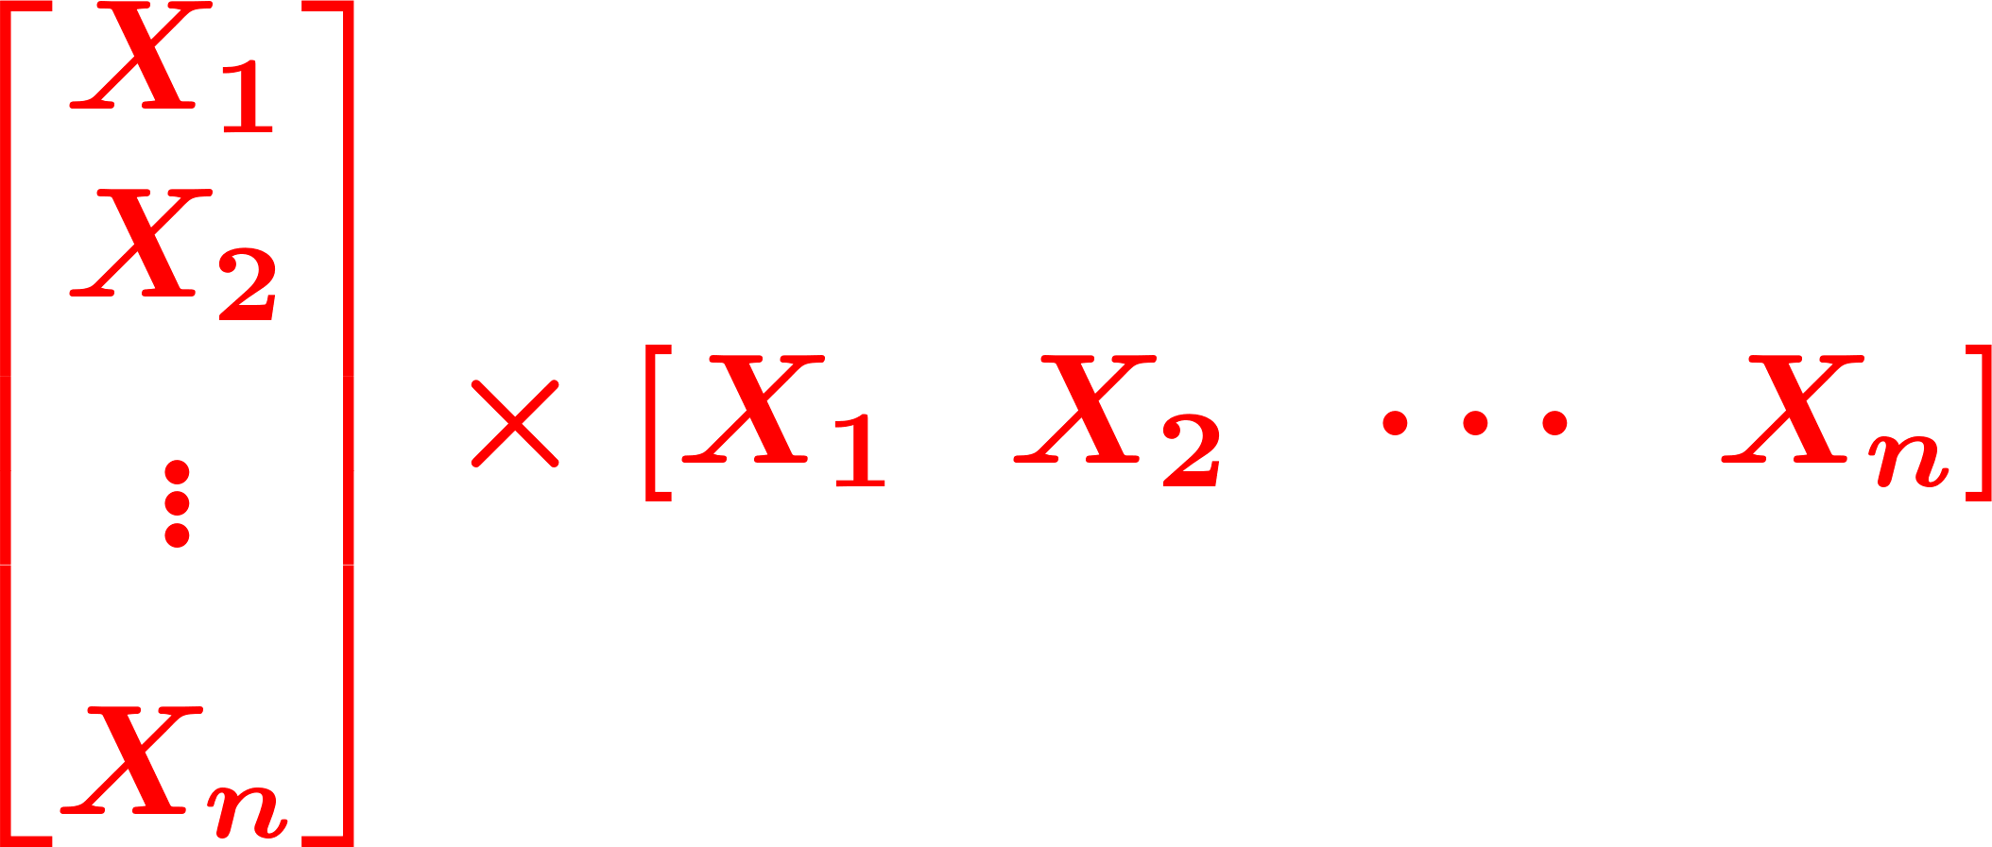
Random Vectors
Correlation and Covariance Matrix
© 2020 UMass Amherst Global. All rights reserved.
Notes:
Now: Slides with Annotation
Next: Slides with Annotation

Slide 42


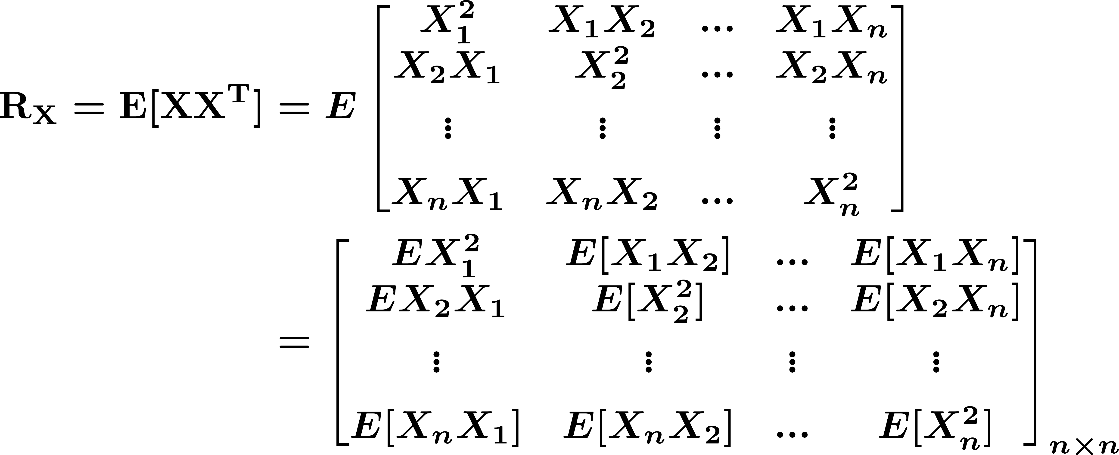
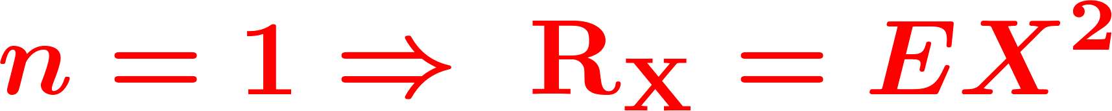
Random Vectors
Correlation and Covariance Matrix
For a random vector , we define the correlation matrix, , as
© 2020 UMass Amherst Global. All rights reserved.
Notes:
Now: Slides with Annotation
Next: Slides with Annotation

Slide 43
Random Vectors
Covariance
© 2020 UMass Amherst Global. All rights reserved.
Notes:
Now: Slides with Annotation
Next: Slides with Annotation

Slide 44

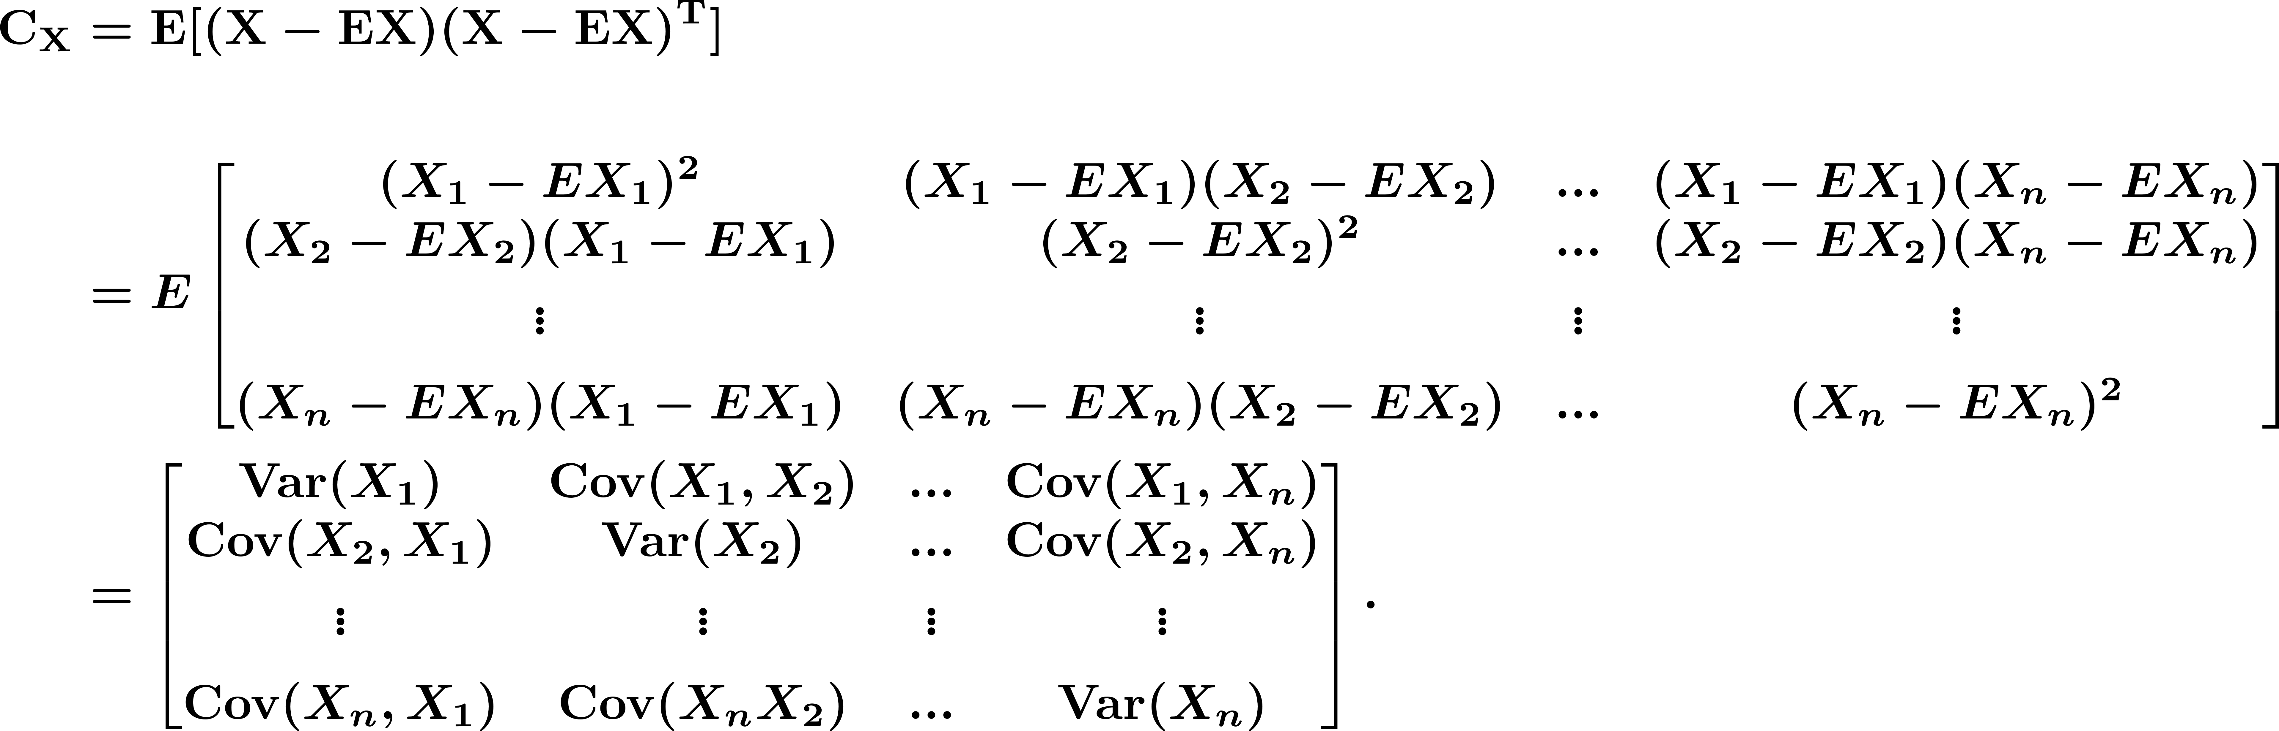
Random Vectors
The covariance matrix, , is defined as
© 2020 UMass Amherst Global. All rights reserved.
Notes:
Now: Slides with Annotation
Next: Slides with Annotation

Slide 45
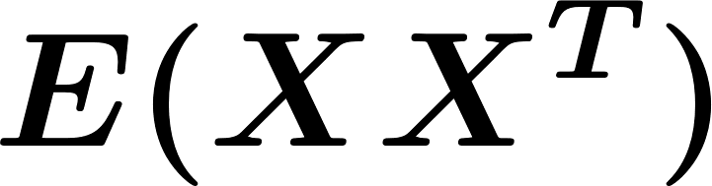
Random Vectors
© 2020 UMass Amherst Global. All rights reserved.
Notes:
Now: Slides with Annotation
Next: Slides with Annotation

Slide 46
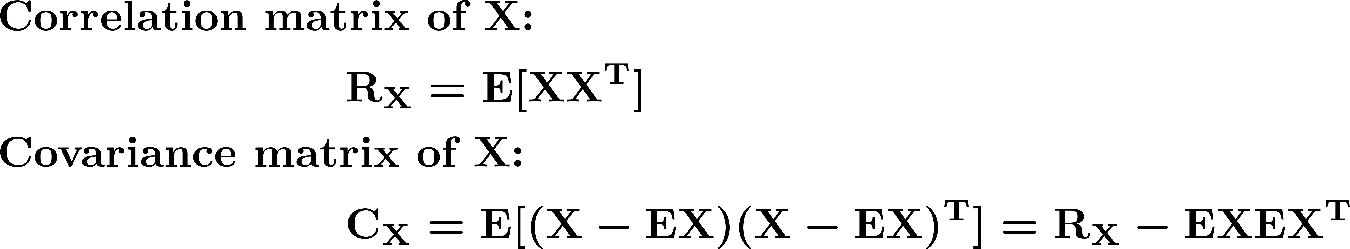
Random Vectors
© 2020 UMass Amherst Global. All rights reserved.
Notes:
Now: Slides with Annotation
Next: Slides with Annotation

Slide 47





Random Vectors
Example. Let be an -dimensional random vector and the random vector be defined as
where is a fixed by matrix and is a fixed -dimensional vector. Show that
© 2020 UMass Amherst Global. All rights reserved.
Notes:
Now: Slides with Annotation
Next: Slides with Annotation

Slide 48
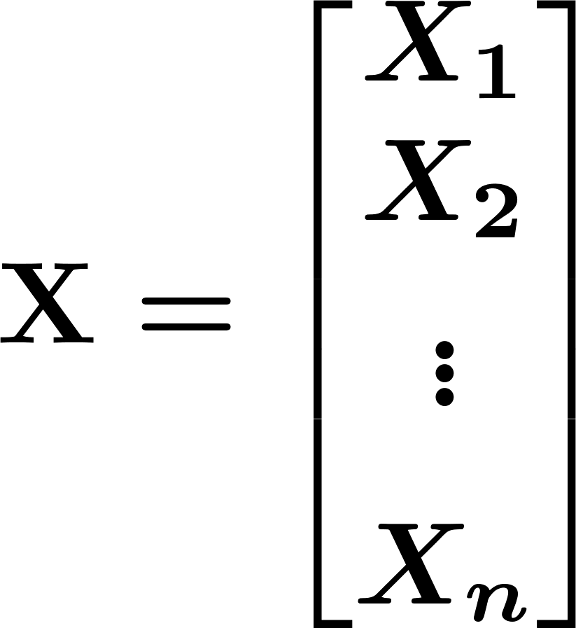
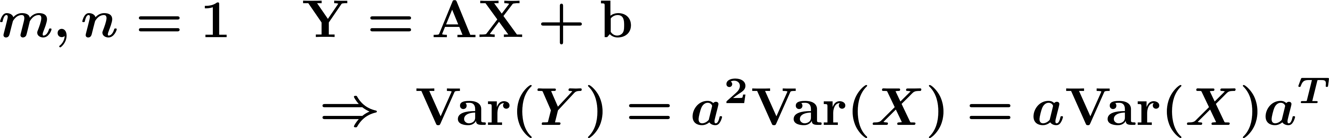
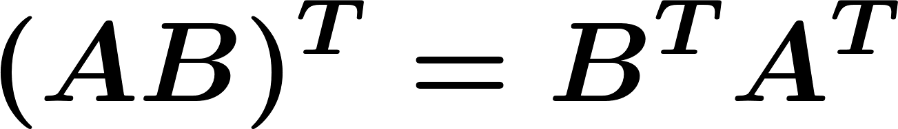
Random Vectors
Note:
© 2020 UMass Amherst Global. All rights reserved.
Notes:
Now: Slides with Annotation
Next: Slides with Annotation

Slide 49

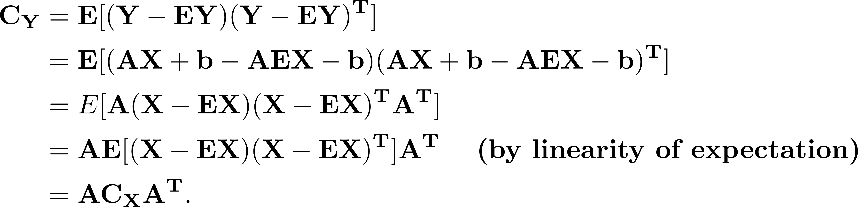
Random Vectors
Proof: Note that by linearity of expectation, we have
By definition, we have
© 2020 UMass Amherst Global. All rights reserved.
Notes:
Now: Slides with Annotation
Next: Slides with Annotation

Slide 50
Random Vectors
Normal (Gaussian) Random Vectors:
Random variables are said to be jointly normal if, for all
, the random variable
is a normal random variable.
© 2020 UMass Amherst Global. All rights reserved.
Notes:
Now: Slides with Annotation
Next: Slides with Annotation

Slide 51
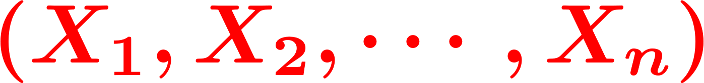
Random Vectors
A random vector
is said to be normal or Gaussian if the random variables are jointly normal.
© 2020 UMass Amherst Global. All rights reserved.
Notes:
Now: Slides with Annotation
Next: Slides with Annotation

Slide 52
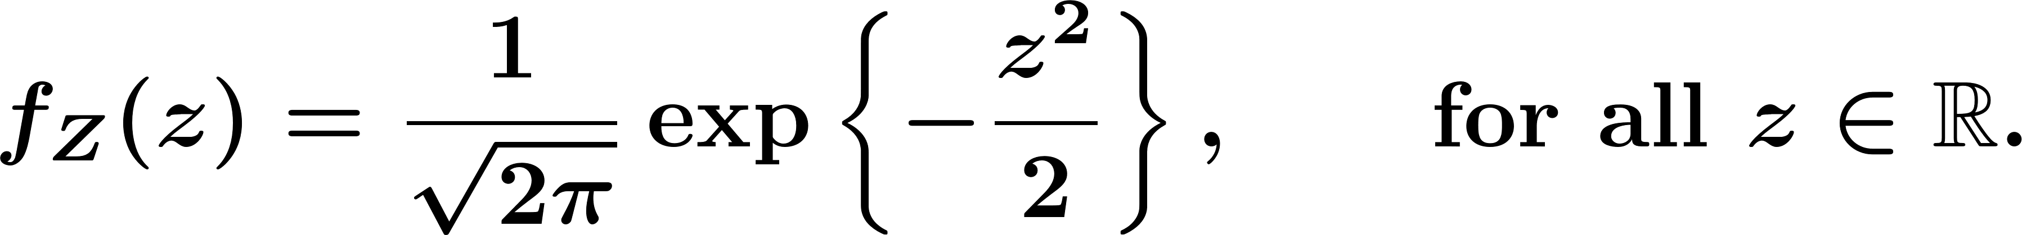
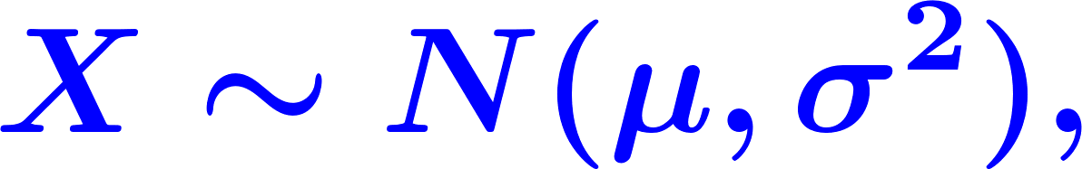
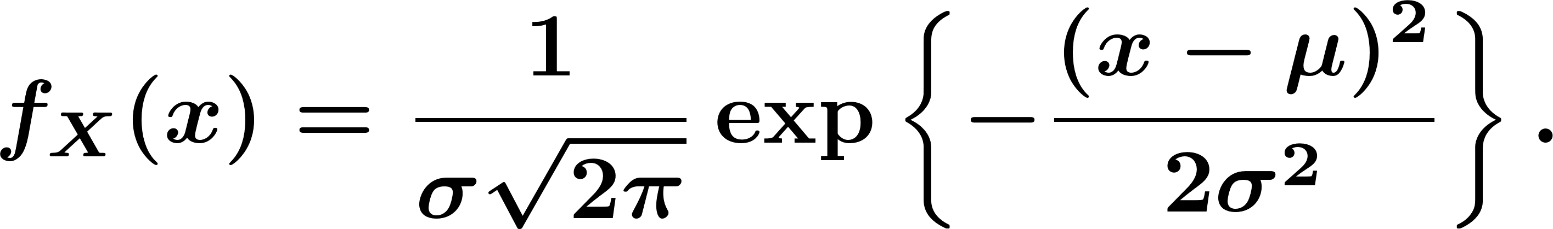
Random Vectors
Standard Normal Random Variable:
© 2020 UMass Amherst Global. All rights reserved.
Notes:
Now: Slides with Annotation
Next: Slides with Annotation

Slide 53


Random Vectors
Standard normal random vector:
© 2020 UMass Amherst Global. All rights reserved.
Notes:
Now: Slides with Annotation
Next: Slides with Annotation

Slide 54


Random Vectors
Then,
© 2020 UMass Amherst Global. All rights reserved.
Notes:
Now: Slides with Annotation
Next: Slides with Annotation

Slide 55




Random Vectors
For a standard normal random vector , where 's are i.i.d. and , the PDF is given by
© 2020 UMass Amherst Global. All rights reserved.
Notes:
Now: Slides with Annotation
Next: Slides with Annotation

Slide 56


Random Vectors
Generally,
For a normal random vector with mean and covariance matrix , the PDF is given by
© 2020 UMass Amherst Global. All rights reserved.
Notes:
Now: Slides with Annotation
Next: Slides with Annotation

Slide 57





Random Vectors
If is a normal random vector, and we know
for all , then are independent.
Another important result is that if
© 2020 UMass Amherst Global. All rights reserved.
Notes:
Now: Slides with Annotation
Next: Slides with Annotation

Slide 58




Random Vectors
If is a normal random vector, , is an by fixed matrix, and is an -dimensional fixed vector, then the random vector is a normal random vector with mean and covariance matrix .
© 2020 UMass Amherst Global. All rights reserved.
Notes:
Now: Slides with Annotation
Next: Slides with Annotation

Slide 59






Random Vectors
Example. Let be a normal random vector with the following mean vector and covariance matrix
Let also
© 2020 UMass Amherst Global. All rights reserved.
Notes:
Now: Slides with Annotation
Next: Slides with Annotation

Slide 60




Random Vectors
Find
Find the expected value vector of
Find the covariance matrix of
Find
© 2020 UMass Amherst Global. All rights reserved.
Notes:
Now: Slides with Annotation
Next: Slides with Annotation

Slide 61
Probability Bounds
Union Bound and its Extensions
Markov and Chebyshev's Inequalities
Chernoff Bounds
Cauchy‐Schwarz Inequality
Jenson's Inequality
© 2020 UMass Amherst Global. All rights reserved.
Notes:
Now: Slides with Annotation
Next: Slides with Annotation

Slide 62
Probability Bounds
Usefulness:
Generality
When exact computation is not possible.
© 2020 UMass Amherst Global. All rights reserved.
Notes:
Now: Slides with Annotation
Next: Slides with Annotation

Slide 63

Probability Bounds
Remember:
More generally:
© 2020 UMass Amherst Global. All rights reserved.
Notes:
Now: Slides with Annotation
Next: Slides with Annotation

Slide 64


Probability Bounds
The Union Bound
For any events , we have
© 2020 UMass Amherst Global. All rights reserved.
Notes:
Now: Slides with Annotation
Next: Slides with Annotation

Slide 65





Probability Bounds
Example. Random Graphs: .
The number of nodes
Probability of connection between two nodes (independent from other edges).
© 2020 UMass Amherst Global. All rights reserved.
Notes:
Now: Slides with Annotation
Next: Slides with Annotation

Slide 66





Probability Bounds
Example. Let be the event that a graph randomly generated according to
model has at least one isolated node (a node that is not connected to
any other nodes). Show that
And conclude that for any , if then
© 2020 UMass Amherst Global. All rights reserved.
Notes:
Now: Slides with Annotation
Next: Slides with Annotation

Slide 67


Probability Bounds
It is an interesting exercise to calculate exactly using the inclusion-exclusion principle:
© 2020 UMass Amherst Global. All rights reserved.
Notes:
Now: Slides with Annotation
Next: Slides with Annotation

Slide 68

Probability Bounds
Generalization of the Union Bound: Bonferroni Inequalities
For any events , we have
© 2020 UMass Amherst Global. All rights reserved.
Notes:
Now: Slides with Annotation
Next: Slides with Annotation

Slide 69

Probability Bounds
Markov's Inequality
If is any nonnegative random variable, then
© 2020 UMass Amherst Global. All rights reserved.
Notes:
Now: Slides with Annotation
Next: Slides with Annotation

Slide 70



Probability Bounds
Let be any positive continuous random variable, we can write
© 2020 UMass Amherst Global. All rights reserved.
Notes:
Now: Slides with Annotation
Next: Slides with Annotation

Slide 71


Probability Bounds
Chebyshev's Inequality
If is any random variable, then for any , we have
© 2020 UMass Amherst Global. All rights reserved.
Notes:
Now: Slides with Annotation
Next: Slides with Annotation

Slide 72


Probability Bounds
Let be any random variable. If , then is a nonnegative random variable.
© 2020 UMass Amherst Global. All rights reserved.
Notes:
Now: Slides with Annotation
Next: Slides with Annotation

Slide 73
Probability Bounds
Chernoff Bounds
© 2020 UMass Amherst Global. All rights reserved.
Notes:
Now: Slides with Annotation
Next: Slides with Annotation

Slide 74


Probability Bounds
For , we can write
© 2020 UMass Amherst Global. All rights reserved.
Notes:
Now: Slides with Annotation
Next: Slides with Annotation

Slide 75


Probability Bounds
Cauchy-Schwarz Inequality
For any two random variables and , we have
where equality holds if and only if , for some constant
© 2020 UMass Amherst Global. All rights reserved.
Notes:
Now: Slides with Annotation
Next: Slides with Annotation

Slide 76


Probability Bounds
assuming
© 2020 UMass Amherst Global. All rights reserved.
Notes:
Now: Slides with Annotation
Next: Slides with Annotation

Slide 77


Probability Bounds
Jensen's Inequality
Remember
If
© 2020 UMass Amherst Global. All rights reserved.
Notes:
Now: Slides with Annotation
Next: Slides with Annotation

Slide 78




Probability Bounds
Jensen's Inequality
© 2020 UMass Amherst Global. All rights reserved.
Notes:
Now: Slides with Annotation
Next: Slides with Annotation

Slide 79







Probability Bounds
Definition. Consider a function , where is an interval in . We
say that is a convex function if, for any two points and in and any
, we have
We say that is concave if
© 2020 UMass Amherst Global. All rights reserved.
Notes:
Now: Slides with Annotation
Next: Slides with Annotation

Slide 80




Probability Bounds
Jensen's Inequality
If is a convex function on , and and are finite, then
© 2020 UMass Amherst Global. All rights reserved.
Notes:
Now: Slides with Annotation
Next: Slides with Annotation

Slide 81


Probability Bounds
A twice-differentiable function is convex if and only if
for all
© 2020 UMass Amherst Global. All rights reserved.
Notes:
Now: Slides with Annotation
Next: Slides with Annotation

Slide 82
Post-work for Lesson
Complete homework assignment for Lessons 14-16:
HW#8
Go to the online classroom for details.
© 2020 UMass Amherst Global. All rights reserved.
Notes:
Now: Slides with Annotation
Next: Slides with Annotation

Slide 83
To Prepare for the Next Lesson
Read Chapter 7 in your online textbook:
https://www.probabilitycourse.com/chapter6/6_0_0_intro.php
Complete the Pre-work for Lesson 17.
Visit the online classroom for details.
© 2020 UMass Amherst Global. All rights reserved.
Notes:
Now: Slides with Annotation

